Slide 1

Electrically driven phenomena in
ferroelectric materials
Alexei Grigoriev
The University of Tulsa
February 22, Wichita State University
Notes:
I’ll talk about interfacial effects in thin ferroelectric films and multilayers.

Slide 2
Motivation
Challenges
Experimental Approaches
Results
Summary

Slide 3
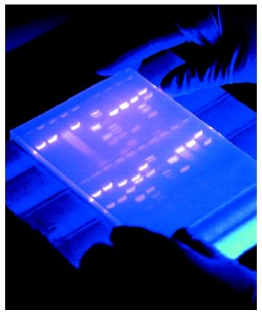
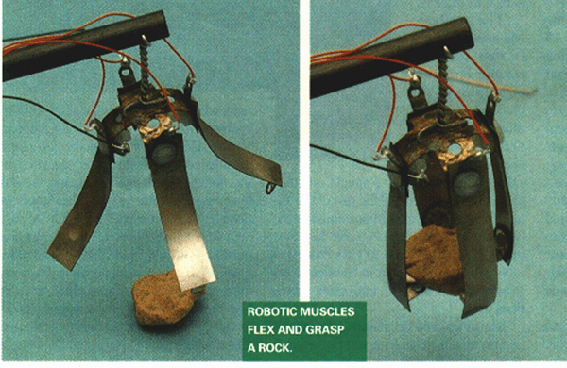
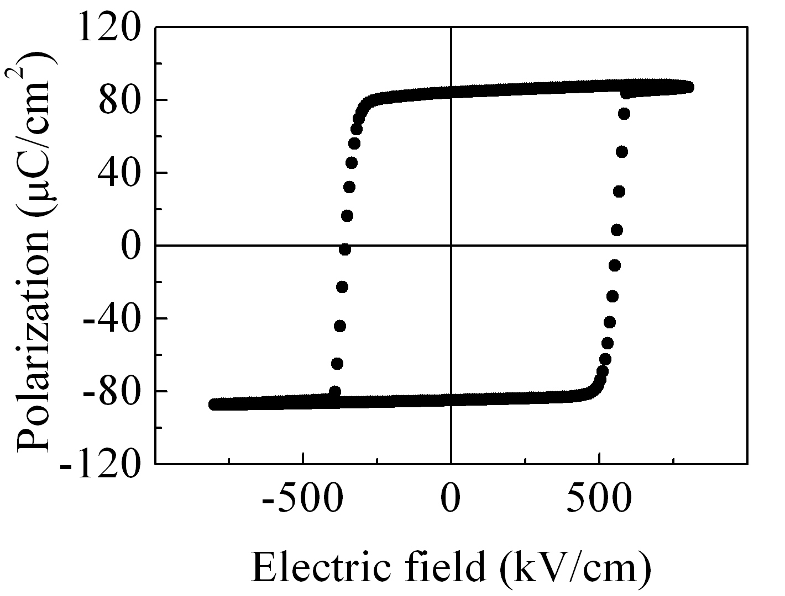
Electric-field driven phenomena
electrophoresis
electrostriction
How do the properties of materials change at high electric fields?
10²
10³
10⁴
10⁵
10⁶
10⁷
10⁸
ferroelectricity
E (V/cm)
alignment
assembly
APL 77,
1399 (2000)

Slide 4
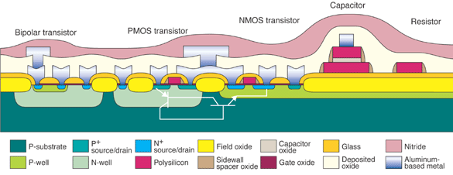
Importance of Nanoscale Oxide Materials
Gate oxide thickness is ~1 nm
1 Volt across 1 nm
10 MV/cm
Partial cross section of a typical silicon CMOS integrated circuit.
J. Scarpulla and A. Yarbrough, Crosslink 4, 15 (2003)
It is important to understand nanoscale properties of ferroelectric oxide thin films at high electric fields.
Notes:
The thickness of gate oxides in nanoelectronic devices approaches 1 nm that translates into 10 MV/cm electric fields at applied voltages of just 1 V. It is generally unknown how the materials’ properties will change at these huge fields. It is therefore crucial to understand the changes of ferroelectric oxide properties at the nanometer length scale.

Slide 5
Ferroelectric oxides
Coupling between electric polarization
and elastic strain
Polarization
P
E
Electric
field
Stress
σ
ε
Strain
External electric field can control
strain (piezoelectric effect) and
polarization (polarization switching).
Notes:
Ferroelectric properties arise from the strong coupling between electrical polarization and elastic strain, which can be controlled by external parameters including stress and electric field.

Slide 6
Ferroelectric phase transition
Cubic
Pb
Pb(ZrTi)O₃ (PZT) phase diagram
Ti
O
Tetragonal non-centrosymmetric
E. Cross, Nature 432, 24 (2004).
P
Examples: perovskite ferroelectrics (BaTiO₃, Pb(ZrTi)O₃), liquid crystal ferroelectrics, organic ferroelectrics

Slide 7
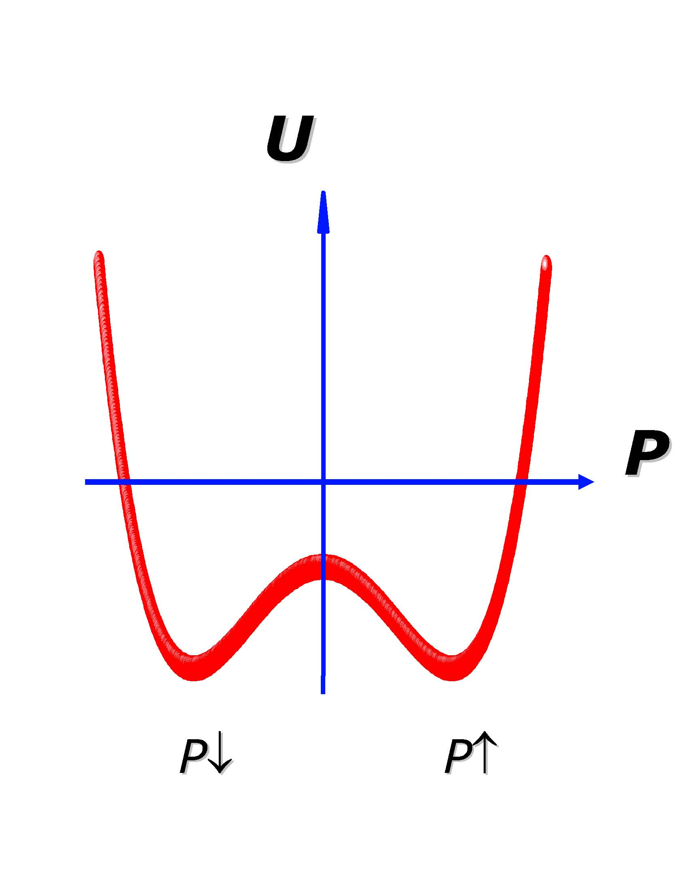
Spontaneous polarization and piezoelectricity
Multiple energetically equivalent configurations
Pb
O
P
P
Ti
Piezoelectric strain
ε ∝ P ⋅E
P

Slide 8
Spontaneous polarization and piezoelectricity
Multiple energetically equivalent configurations
Pb
O
P
P
Ti
Piezoelectric strain
ε ∝ P ⋅E
E
P

Slide 9
Spontaneous polarization and piezoelectricity
Multiple energetically equivalent configurations
Pb
O
P
P
Ti
Piezoelectric strain
ε ∝ P ⋅E
E
E
P
P

Slide 10
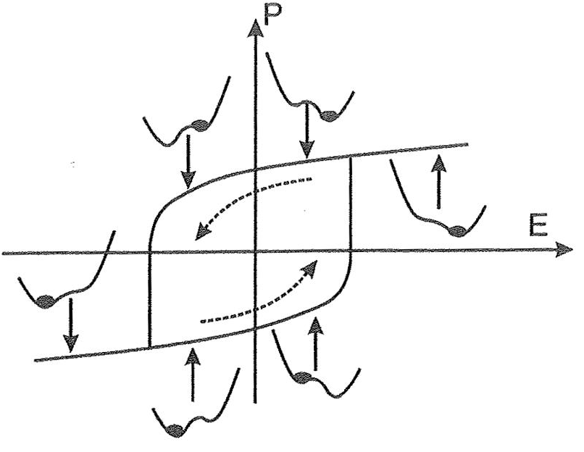
Hysteresis in an idealized ferroelectric
E = 0
E ≠ 0
From “Physics of Ferroelectrics: a Modern Perspective”
(Springer-Verlag, Berlin Heidelberg, 2007)

Slide 11
Ferroelectric oxides and their applications
Properties
Some Applications
Switchable
polarization
Nonvolatile
memories
Energy
Piezoelectricity
Transducers,
energy harvesting
Ferroelectric
oxides
Information
technology
Pyroelectricity
IR detectors
High dielectric
constants
Gate dielectrics
Defense
Nonlinear
optical
properties
EO modulators
Notes:
Ferroelectric properties of complex oxide materials are used in a broad range of applications in the areas of energy, information technology and defense, so the importance of ferroelectrics is hard to overestimate. In this talk I will focus on two of the properties – switchable polarization and piezoelectric strain.

Slide 12
Domain wall propagation in thin films
Elastic forces come from the curvature of domain wall, defects work as strong pinning sites.
Domain-wall velocity vs. electric field in a system governed by competition between disorder and elasticity effects.
From J. Y. Jo, PRL 102, 045701 (2009).
Switching thermodynamics, pinning/depinning, charge transport are important at different scales of time, length, and electric field.
Notes:
In realistic thin films, domain wall motion is strongly affected by switching thermodynamics, pinnining/depinning by defects, and transport of electrical charges in the film. In this talk, I will show you how such effects can change the expected ideal switching dynamics in ultrathin ferroelectric films.

Slide 13
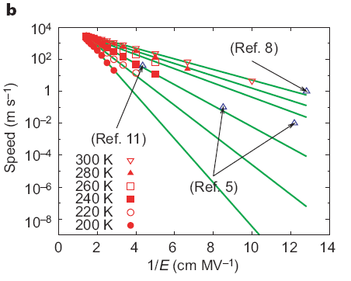
Polarization domain wall dynamics
MD calculations of the domain wall velocity in PbTiO₃.
Y.H. Shin et al., Nature 449, 881 (2007)
It might be possible to test these predictions in ultrathin films at high electric fields.
Notes:
Polarization switching in thin films is generally controlled by nucleation and propagation of polarization domains. Polarization domain dynamics depends strongly on applied electric field and it is predicted that the domain wall velocity can reach hundreds and even thousands of m/s at high enough fields. In thin films we should be able to test these predictions using relatively moderate voltages.

Slide 14
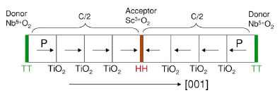
New opportunities with ferroelectric multilayers
Proposed PbTiO₃-based multilayer with head-to-head or tail-to-tail
180⁰-degrees polarization domain walls. From X. Wu & D. Vanderbilt, PRB 73, 020103 (2006).
The switchable 2DEG candidate material. DOS at the left and right NbO₂/AO interfaces in (KNbO₃)_{8.5}/(ATiO₃)_{7.5} superlattices for A = Sr (a), A = Ba (b), and A = Pb (c). From M. K. Niranjan et al., PRL 103, 016804 (2009).
New multistate electronic memories, fast nanoelectronics, new EO devices
Is it physically possible to achieve such unusual polarization configurations as head-to-head domains?
Notes:
Ferroelectric oxides are fascinating materials for creating new systems with modified properties, which is due to the oxides chemistry and structure. Some new proposed multilayer materials include multilayers with unusual orientation of polarization domains and polarization-state sensitive electronic structure at the interfaces between different polarization layers. This highlights the importance of the interfaces with ferroelectrics in controlling materials’ properties.

Slide 15
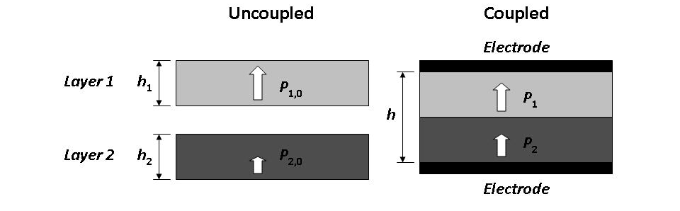
Polarization coupling between ferroelectric layers
Prediction
From J. V. Mantese, and S. P. Alpay, Graded Ferroelectrics, Transcapacitors and Transponents (Springer Science+Business Media, Inc., New York, 2005).
How strong is this polarization coupling in reality?
Notes:
For the most simple bilayer ferroelectric system, polarization difference between the layers should be reduced dramatically in the system with strong interlayer coupling. In some systems such as superlattices this prediction seems to work well, but does this work in bi- or tri-layer ferroelectrics with relatively thick layers allowing for the coupling effects to fade out far from the interface.

Slide 16
Proposed polarization domain structure during polarization switching of a ferroelectric multilayer
A. L. Roytburd, and J. Slutsker, APL 89, 42907 (2006)
How does the polarization of a multilayer switch?
Layer-by-layer, by wedge-like domains, as a single film?
Notes:
At short time scales, polarization switching in multilayer should go through an unstable state with head-to-head or tale-to-tale polarization domain configuration. This may lead to breaking layers into small domains as predicted by Roytburd. To test predictions of polarization dynamics in ferroelectric multilayers it is essential to probe the structure and properties of individual ferroelectric layers during the switching process.

Slide 17
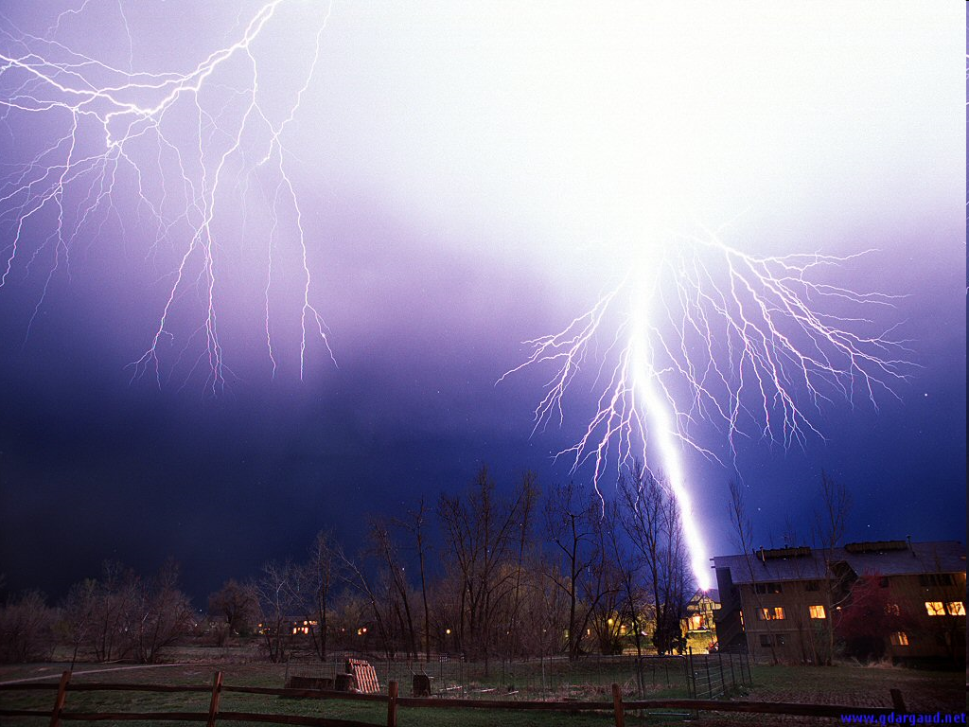
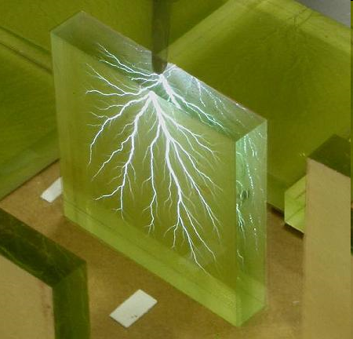
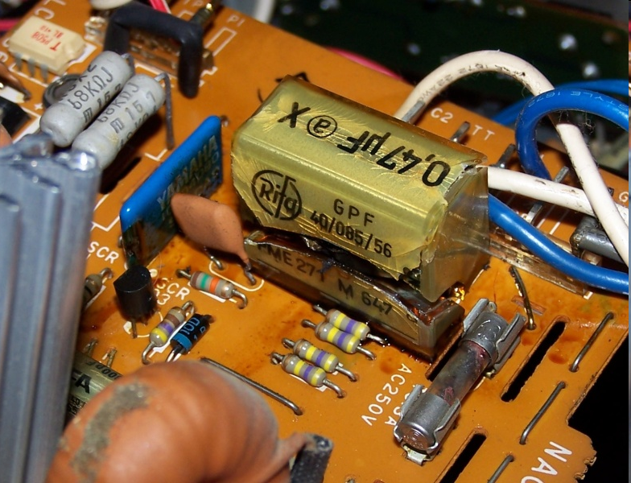
Experimental challenge – dielectric breakdown
Dielectric strength:
in air ~30 kV/cm
in ferroelectric oxides is ≈ 2 MV/cm
Can stronger fields be applied?

Slide 18
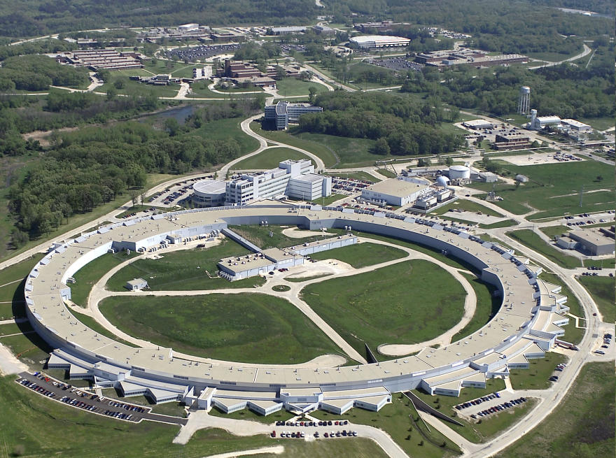
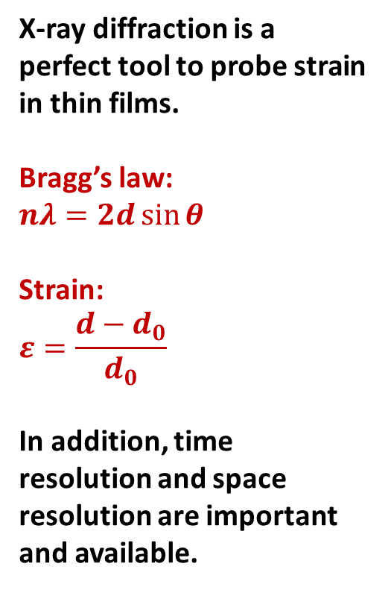
Time-resolved X-ray microdiffraction
detector
X-ray diffraction is a perfect tool to probe strain in thin films.
Bragg’s law:
$$nλ=2d\sin{θ}$$
Strain:
$$ε=\frac{d−d_{0}}{d_{0}}$$
In addition, time resolution and space resolution are important and available.
voltage generator
FE capacitor
synchronization
X rays
Synchrotron, APS, Argonne, IL

Slide 19
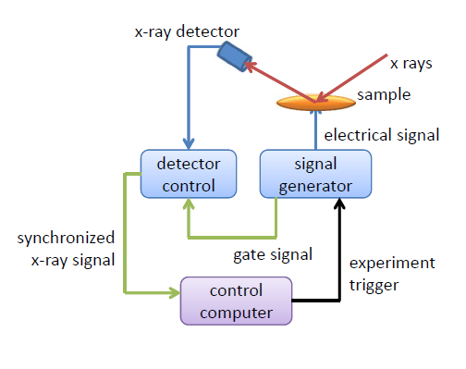
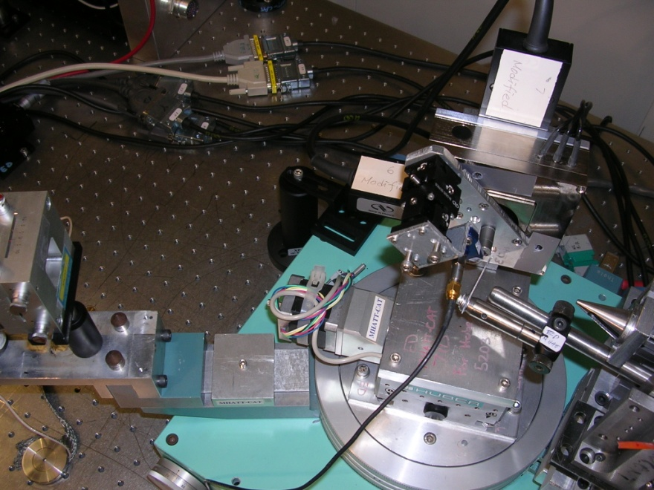
Time-resolved X-ray microdiffraction
Time resolution 100 ps
Sensitivity to small structural changes
Spatial resolution 30 nm
(~100 nm routinely available)
X rays
electrical probe

Slide 20
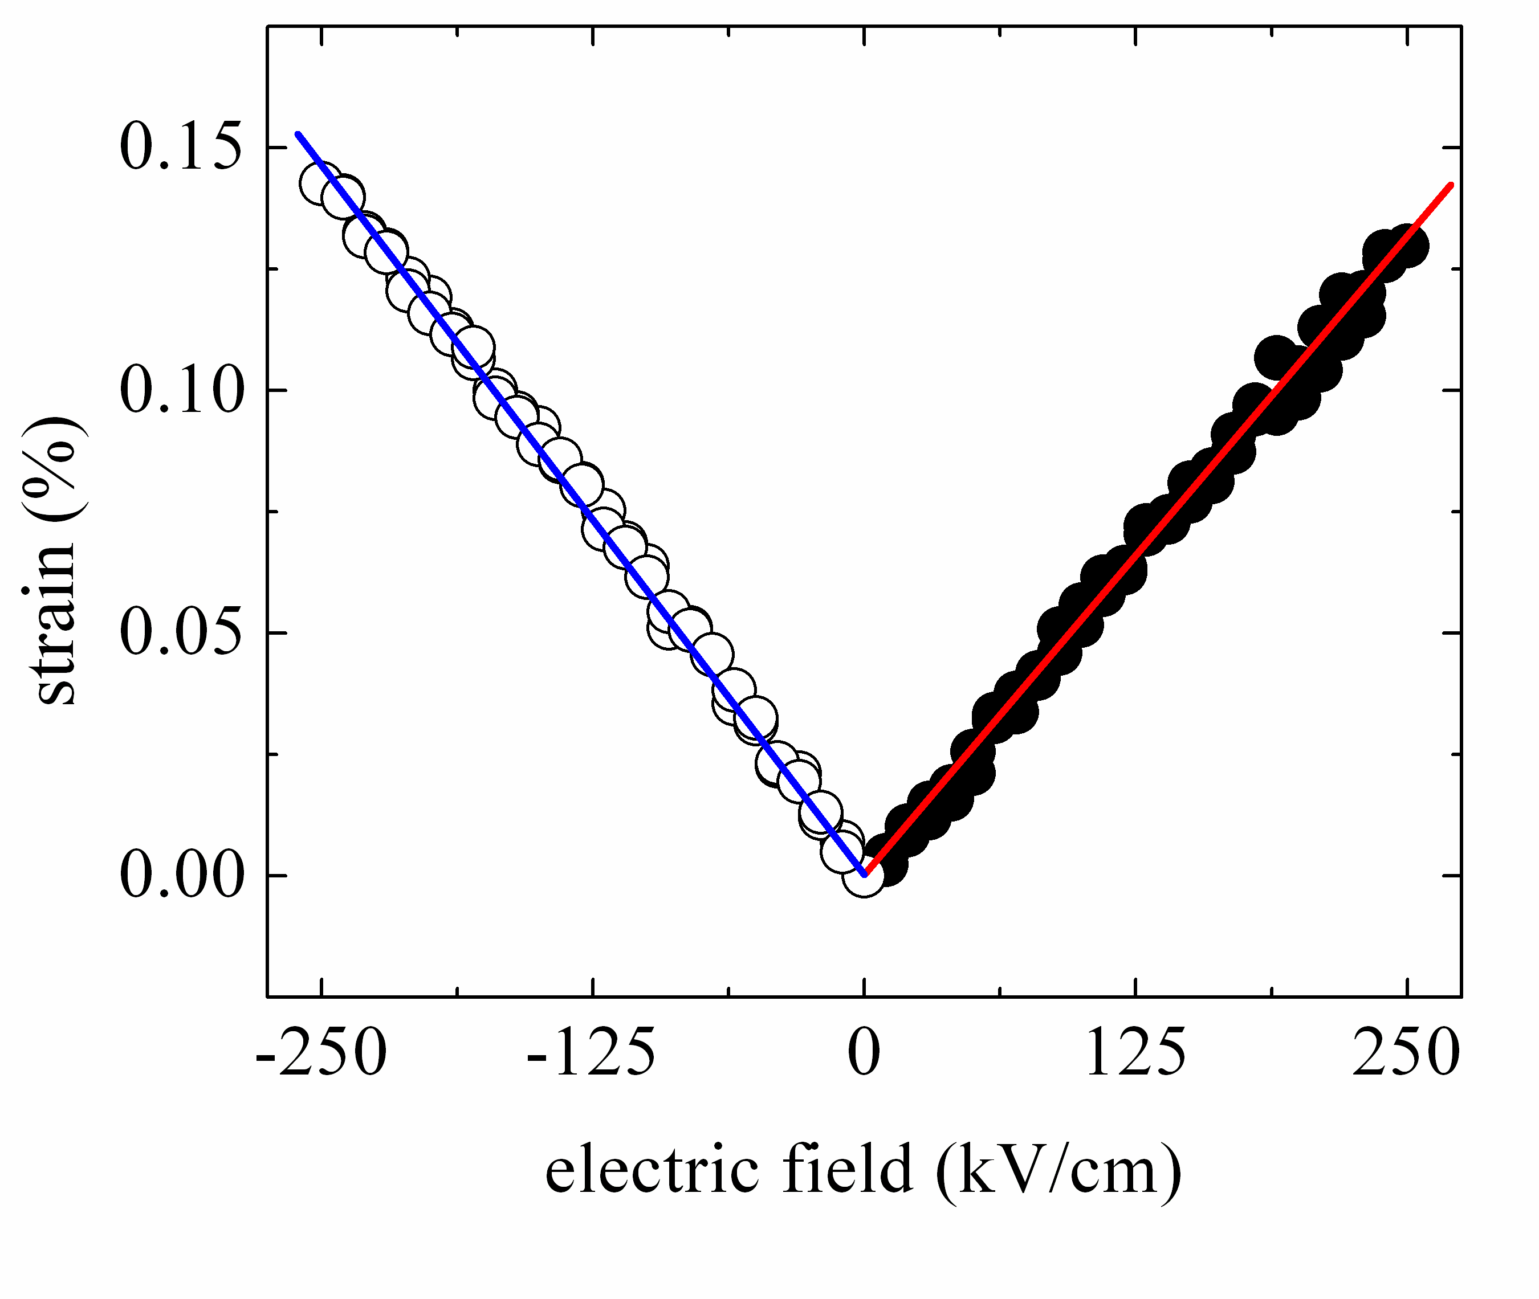
Piezoelectric response of a 400-nm PZT film
measured at the millisecond time scale
At low electric fields ε₃ = d₃₃ ⋅ E₃
d₃₃ ≅ 55 pm/V for Pb(Zr_{0.48}Ti_{0.52})O₃ thin films

Slide 21
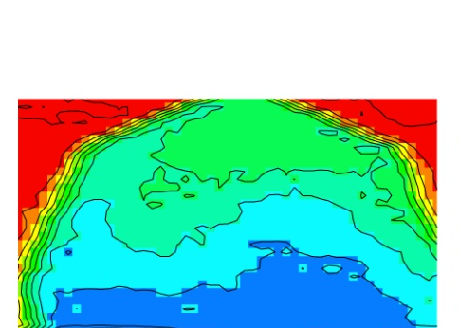
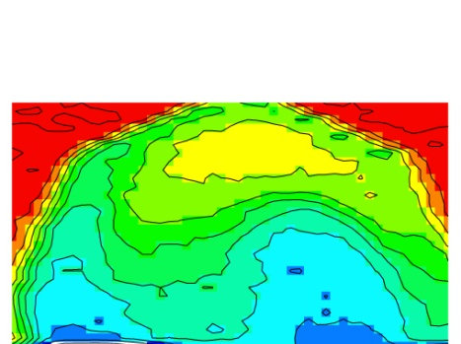
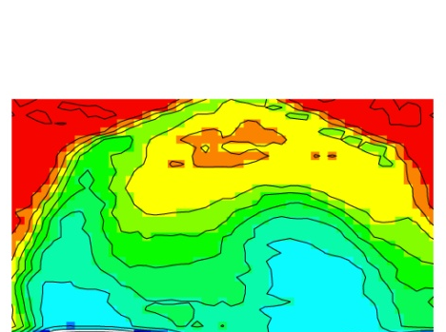
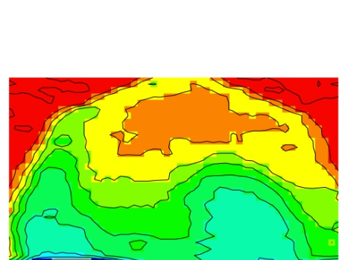

X-ray microdiffraction imaging
Partial polarization switching by pulses of varying durations.
Electric field -1.43 MV/cm
poling
V
t
intensity (normalized
to 100)
1.5 μs
2 μs
2.25 μs
2.5 μs
P↓
P↑
Polarization switches at the microsecond time scale.

Slide 22
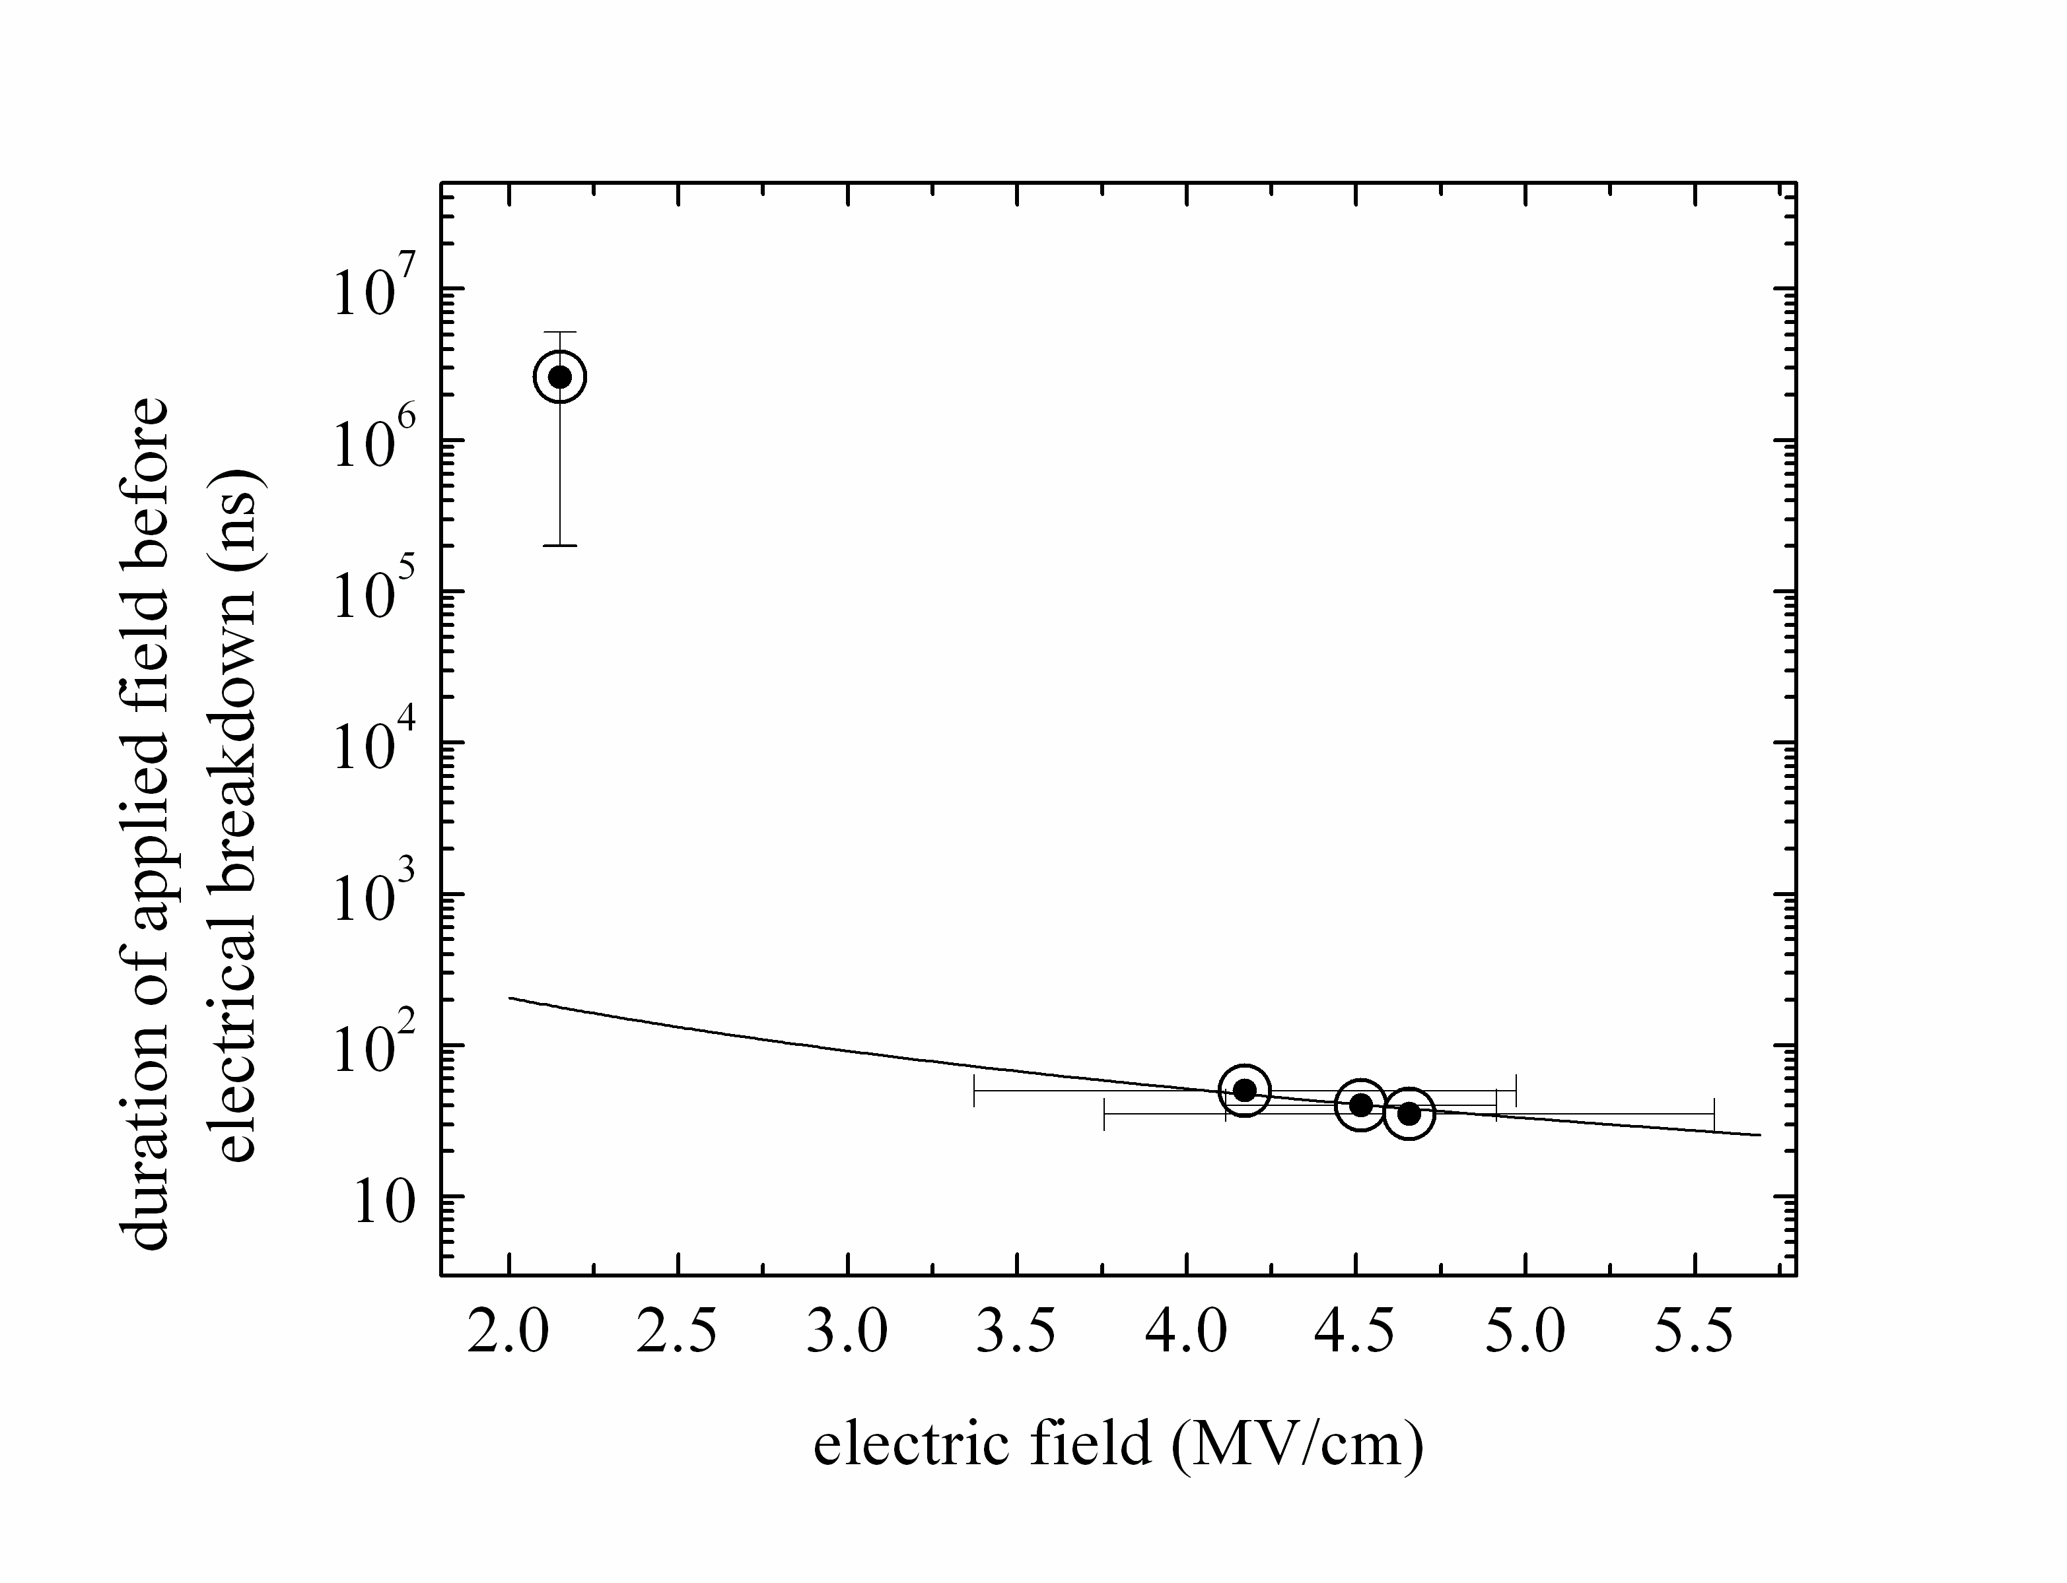
Dielectric breakdown
Experimental challenge: how can we apply high electric fields avoiding irreversible dielectric breakdown?
Breakdown time t ∝ E²
High fields can be applied using short electrical pulses!
PbZr_{0.2}Ti_{0.8}O₃ 35-nm film
50 ns
A. Grigoriev et al., Phys. Rev. Lett. 100, 027608 (2008)

Slide 23
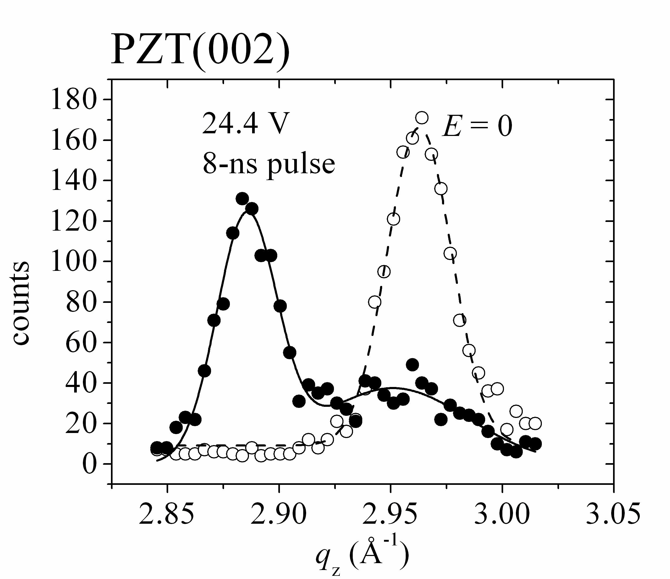
Probing piezoelectric strain at high fields
PbZr_{0.2}Ti_{0.8}O₃ 35-nm film
8 ns electric field pulses
Piezoelectric strain 2.7%
Piezoelectric ceramics ~0.1%
Ferroelectric thin films ≤1.7%
Polymers ~4%
A. Grigoriev et al., Phys. Rev. Lett. 100, 027608 (2008)

Slide 24
Unexpectedly strong response at high electric fields
Strong response at high fields suggests:
- low-field parameters used
in calculations are field-
dependant
- new regimes of interatomic
interactions such as
tetragonality enhancement
may be reached at high
electric fields
line: ε₃ = d₃₃ ⋅ E_{3,} d₃₃ ≅ 45 pm/V
A. Grigoriev et al., Phys. Rev. Lett. 100, 027608 (2008)

Slide 25
New first-principles calculations
A. Roy, M. Stengel, D. Vanderbilt, Physical Review B 81, 014102 (2010)
Even larger intrinsic strains should be allowed in ferroelectric thin films!

Slide 26
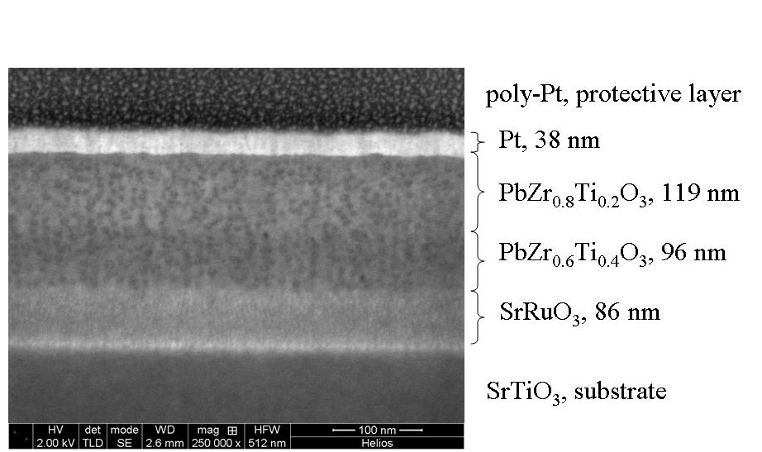
Epitaxial bilayer ferroelectric film
An SEM image of a FIB-milled cross section of a ferroelectric bilayer capacitor

Slide 27
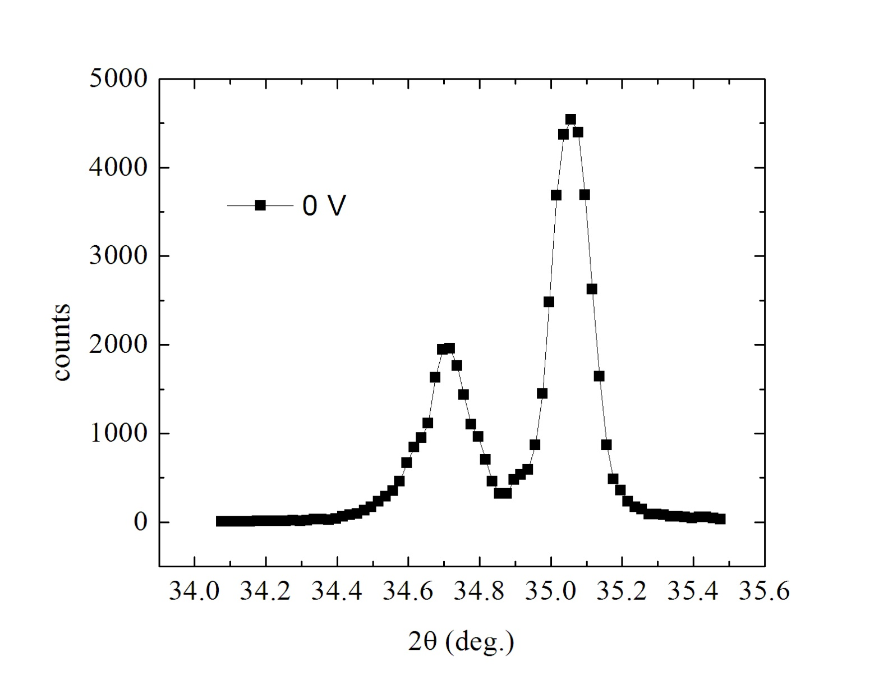
Time-resolved X-ray microdiffraction of a ferroelectric bilayer system
Scans around PZT (002) Bragg peaks
4.11 Å
4.15 Å
V
Bilayer system
Pt
PbZr_{0.8}Ti_{0.2}O₃
100 nm
PbZr_{0.6}Ti_{0.4}O₃
100 nm
SRO/STO

Slide 28
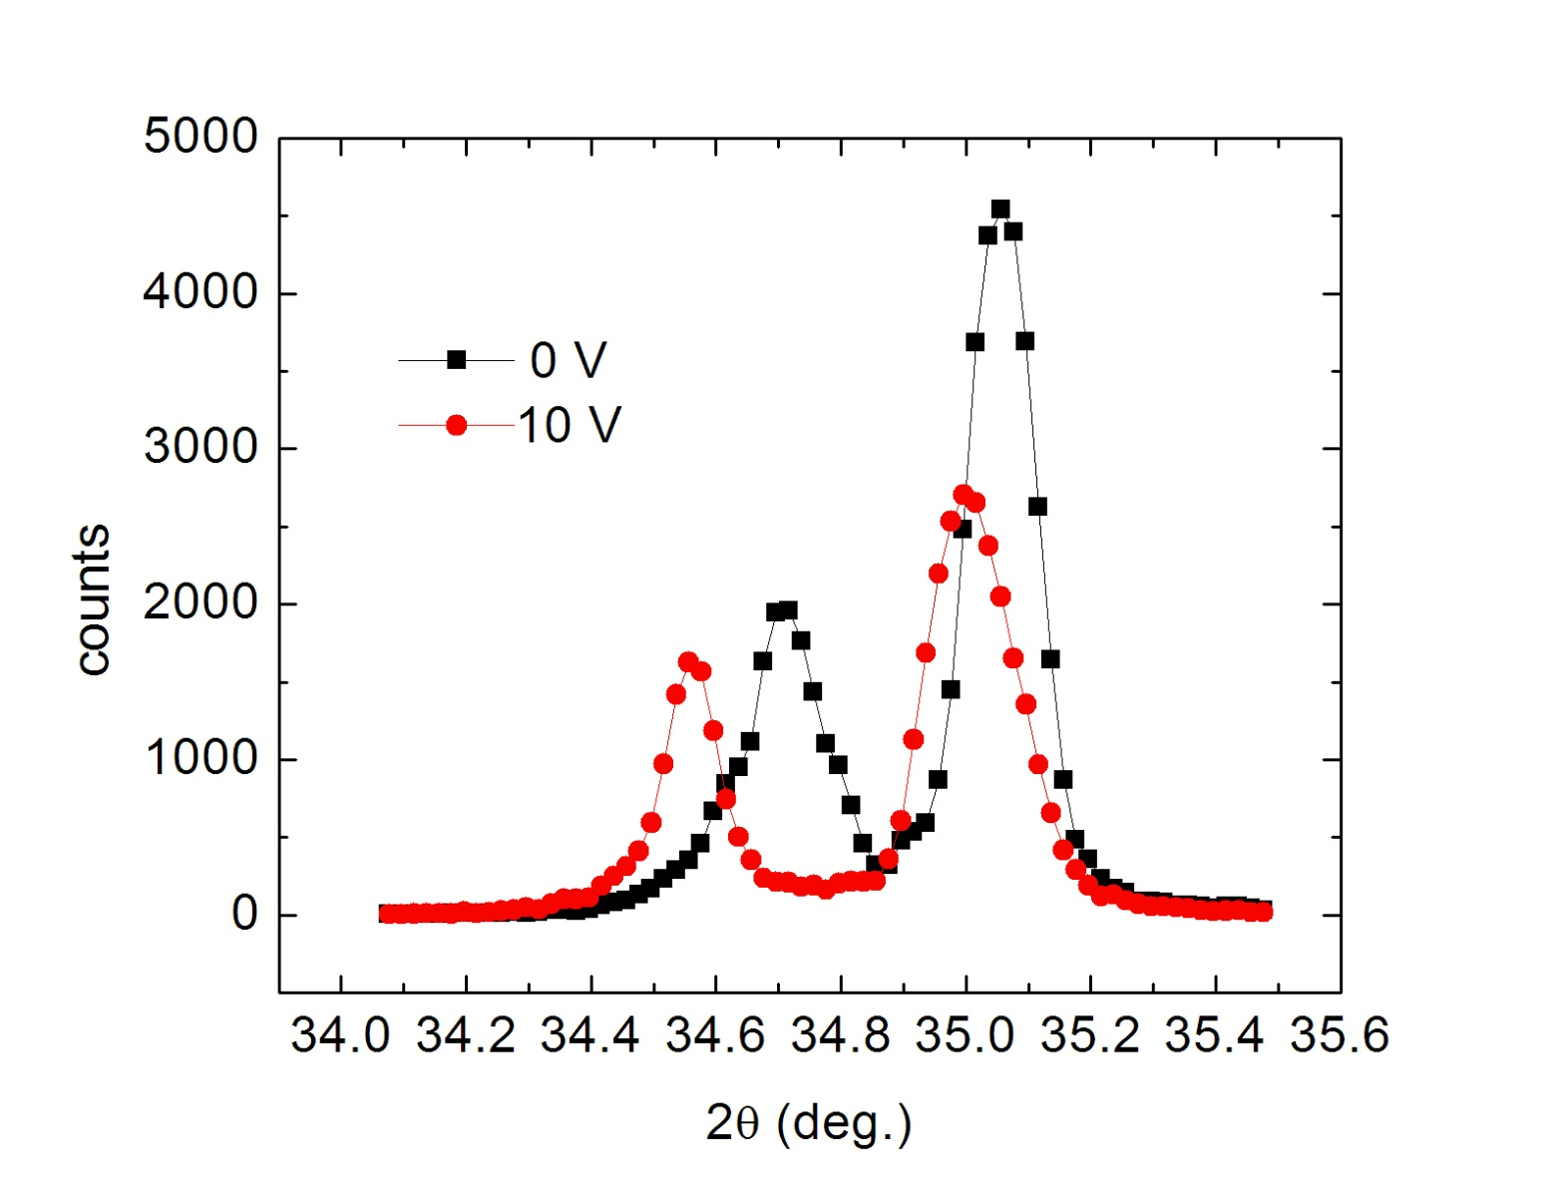
Time-resolved X-ray microdiffraction of a ferroelectric bilayer system
Scans around PZT (002) Bragg peaks
V
Bilayer system
Pt
PbZr_{0.8}Ti_{0.2}O₃
100 nm
PbZr_{0.6}Ti_{0.4}O₃
100 nm
SRO/STO

Slide 29
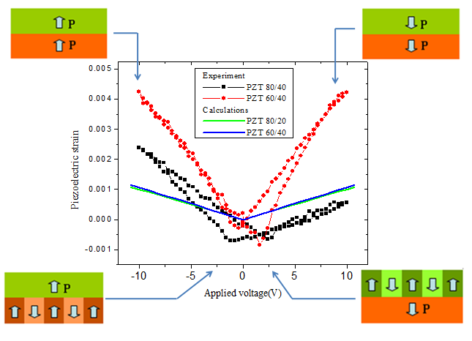
Piezoelectric strain of individual layers
These piezoelectric strain measurements were done using “slow” millisecond time scale pulses.

Slide 30
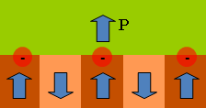
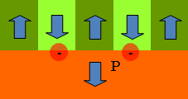
Possible domain configuration
Polarization coupling between the layers is not very strong
Interface charges are likely to play an important role in polarization dynamics
These piezoelectric strain measurements were done using “slow” millisecond time scale pulses.
Can the layers be switched independently with shorter pulses?

Slide 31
Tail-to-tail configuration of polarization domains
at +5V
PZT (80/20)
P
E
+
+
+
+
+
P
PZT (60/40)
Using 5-microsecond pulses, it was possible to switch polarization of the layers in an unusual configuration of tail-to-tail domains.

Slide 32
Summary
Ultrahigh piezoelectric strains can be achieved in ferroelectric oxide thin films at extreme electric fields that can be applied to dielectric materials at the nanosecond time scale without breakdown.
Polarization coupling in ferroelectric bilayers is much weaker than could be expected for the ideal coupling.
It is possible to switch polarization of individual layers independently in a ferroelectric multilayer thin film.
Students: Tara Drwenski, Mandana Meisamiazad
Collaborators:
Wisconsin Paul G Evans, Rebecca Sichel.
Oak Ridge National Laboratory Ho Nyung Lee
Advanced Photon Source Donald Walko, Eric Dufresne
Support: NSF DMR, DOE BES, University of Tulsa faculty development and student support programs

Slide 33
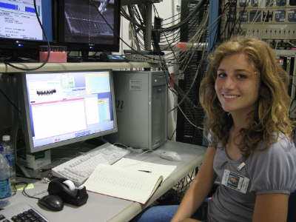
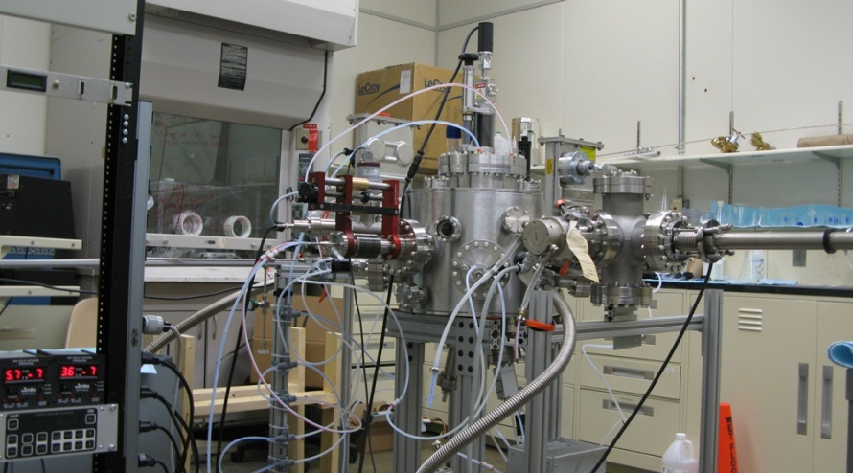
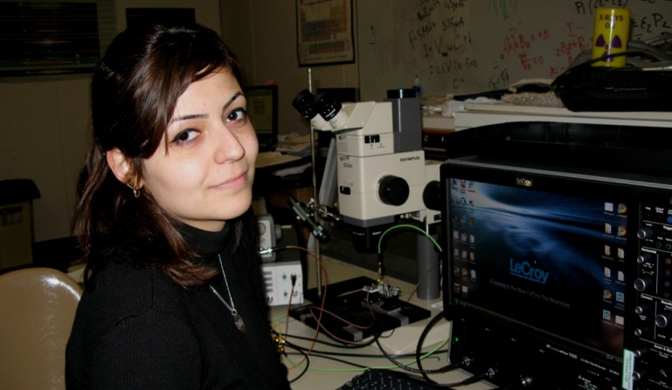
Opportunities at Physics Department at TU
B.S. in Physics and Engineering Physics
M.S. and Ph.D. in Physics
Directions
  Plasma Physics
  Computational Solid State Physics
  Experimental Condensed Matter Physics
  Nanotechnology
  Optics
  Atomic Physics

Slide 34
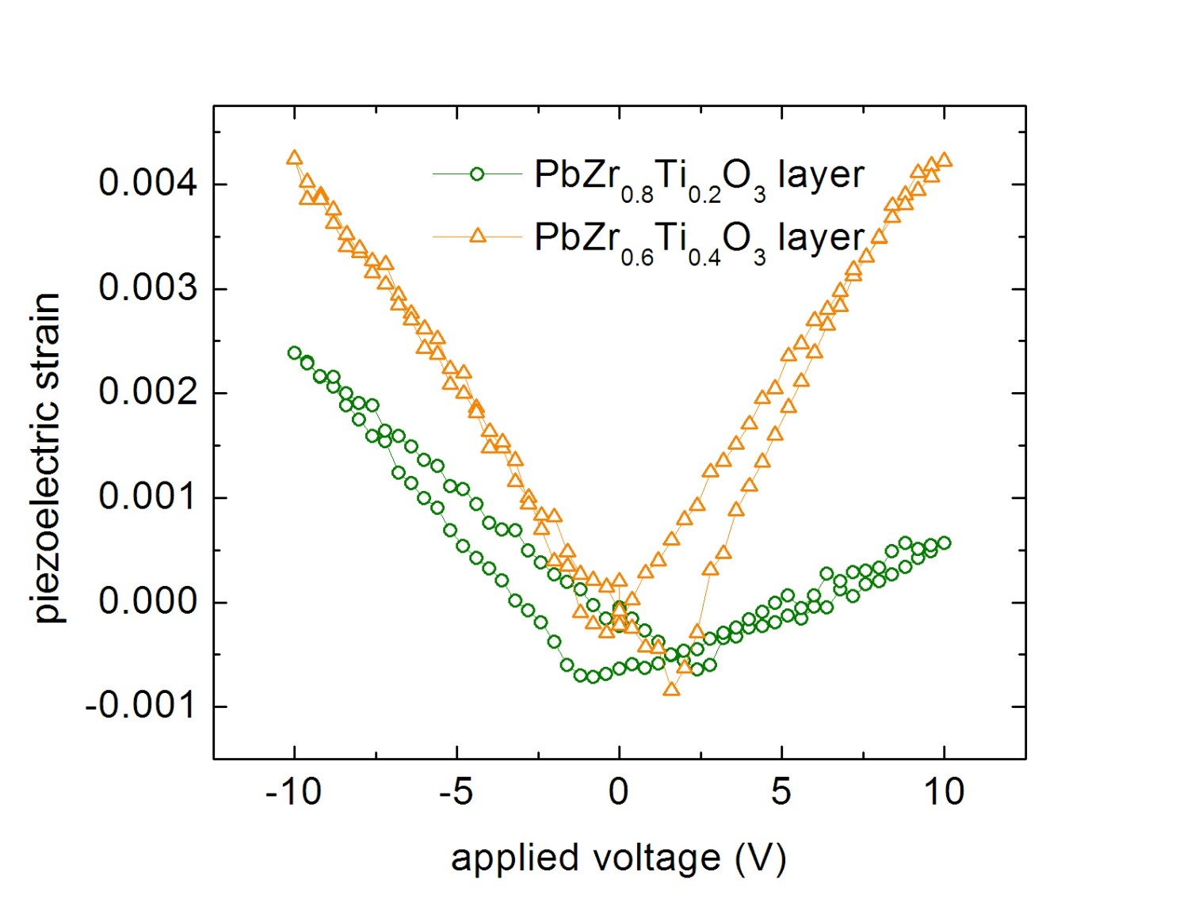
Thank you
PZT (80/20)
at +5V
P
E
+
+
+
+
+
P
PZT (60/40)

