Slide 1

Higgs Boson Mass In Gauge-Mediated
Supersymmetry Breaking
Abdelhamid Albaid
In collaboration with
Prof. K. S. Babu
Spring 2012 Physics Seminar
Wichita State University
April 4 2012

Slide 2
OUTLINE
Background
Standard Model
Higgs Mechanism
Flavor Structure of SM
Shortcomings of SM
Supersymmetry
Interesting Features of MSSM
Supersymmetry Breaking
Shortcomings of MSSM
Grand Unification Theory

Slide 3

OUTLINE
Motivation
Higgs Mass Limit in MSSM.
Updated Experimental Results on the Higgs mass
Gauge Mediated Supersymmetry Breaking (GMSB)
Objectives
Higgs mass in GMSB with messenger-matter Mixing
GMSB with Messenger-Matter Mixing
Higgs Mass Bounds in the Model
Froggatt-Nielsen Mechanism
Flavor Violation
Conclusion

Slide 4
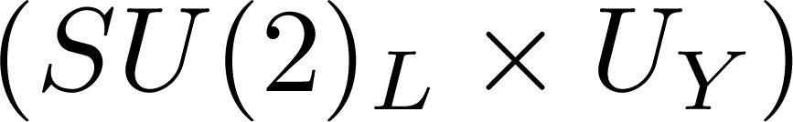
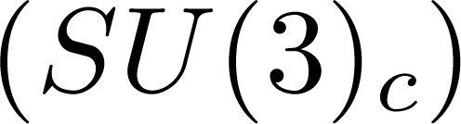



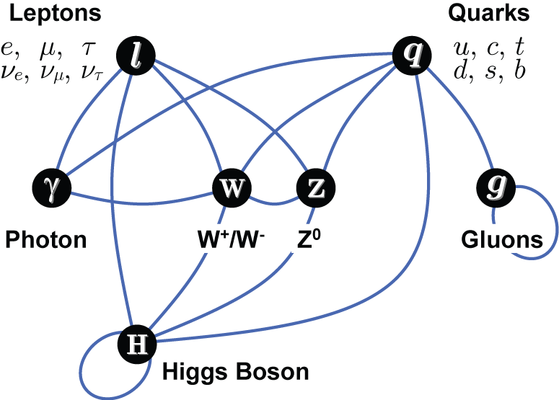
Background
Standard Model (SM)
Four fundamental interactions
Electromagnetic interactions ( Photons)
Weak interactions ( W+/W-, Z)
Strong interactions (gluons)
Gravitational interaction (gravitons)
Glashow-Weinberg-Salam Model
Quantum Chromodynamics (QCD)
SM
Standard Model gauge group
The invariance of local gauge symmetry leads to massless photons and gluons
Gauge Symmetry should be broken spontaneously by employing Higgs Mechanism

Slide 5
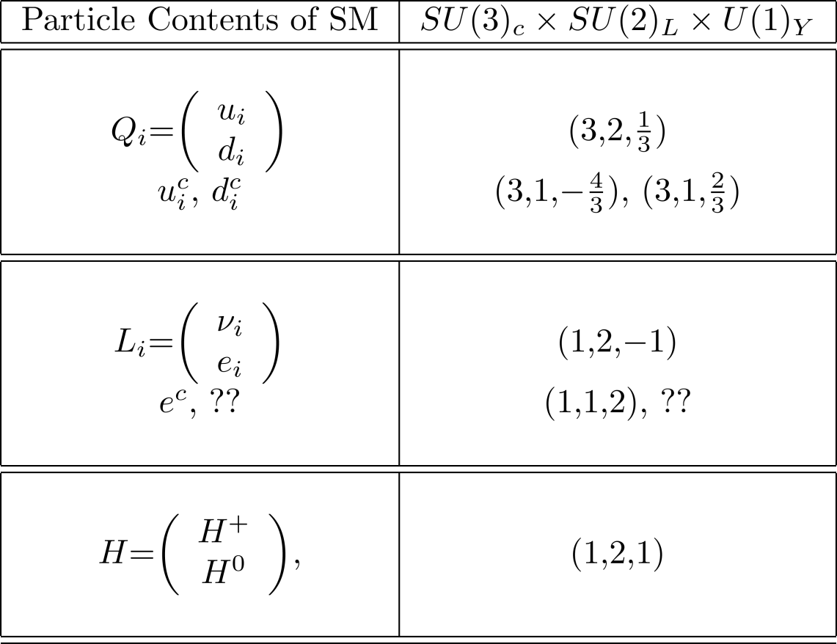

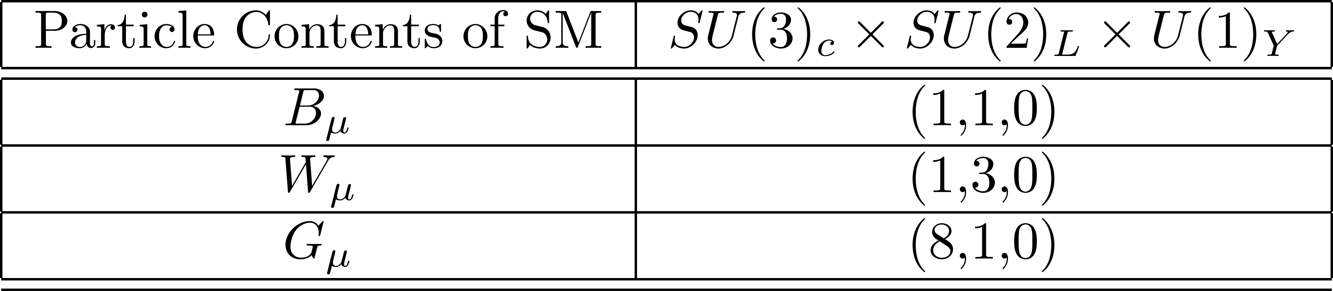
Background
Standard Model (SM)
There is no right handed neutrino in SM.
As a consequence of EWSB
Higgs particle is predicted by SM and finding it might lead to new physics beyond the SM

Slide 6
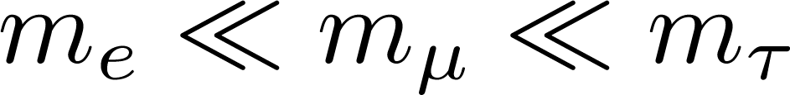
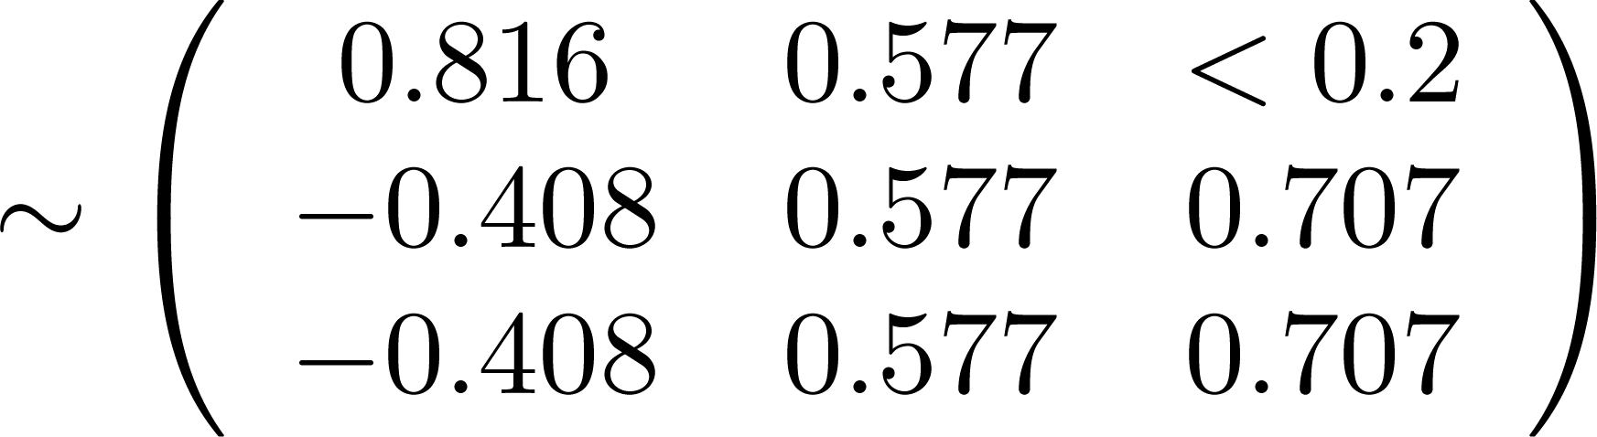
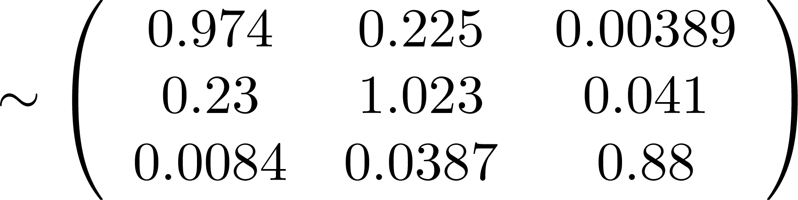

Background
Flavor Structure in SM
Hierarchical Structure ??
Lepton Sector
Quark Sector
Neutrino mixing angles
Quark mixing angles
Is it possible to accommodate large neutrino mixing angles and small quark mixing angles simultaneously in unified framework?
Yes, in doubly lopsided structure,
[Albaid, 2009,2011]
The hierarchical structure of fermion masses and mixings can be understood by employing Froggatt-Nielsen Mechanism

Slide 7
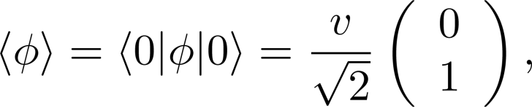

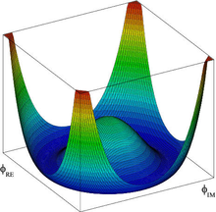

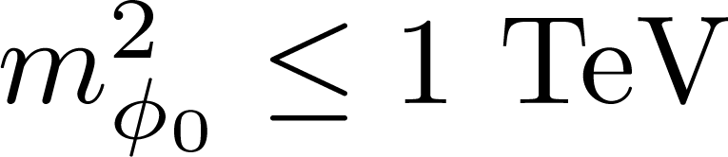
Background
Higgs Mechanism
Higgs potential
Minimizing the potential
The mass of the Higgs boson
For the theory remains perturbative

Slide 8
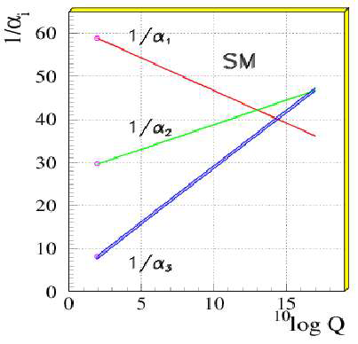
Background
Shortcomings of the Standard Model
doesn’t contain gravity
doesn’t explain neutrino masses.
doesn’t have candidate for dark matter
no unification of gauge couplings possible
gauge hierarchy problem
Higgs mass receives huge quantum corrections

Slide 9
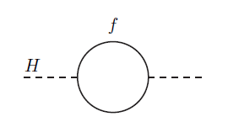
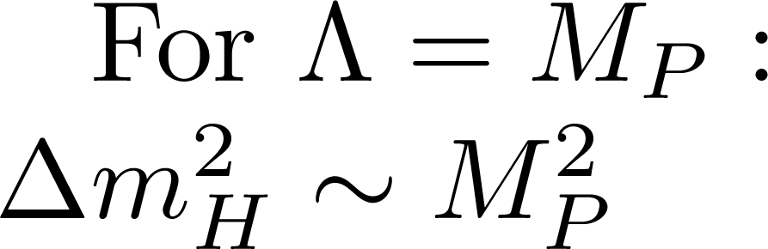
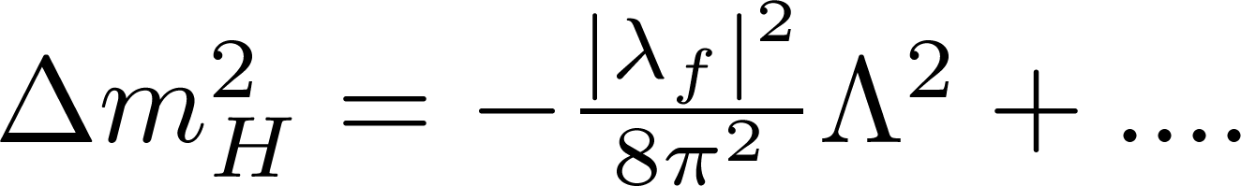
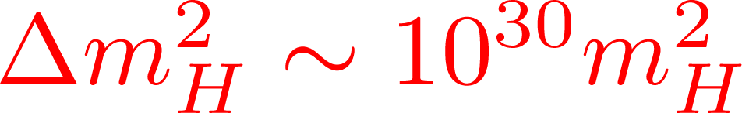

Background
Shortcomings of the Standard Model
cutoff scale
The required value
A promising scenario that solve the hierarchy problem is supersymmetry (SUSY)

Slide 10
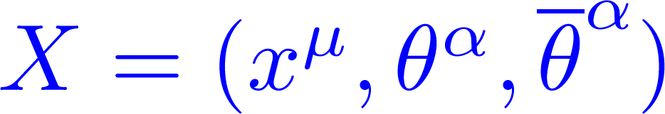
Background
Supersymmetry
Symmetry between fermions and bosons
Q | boson > = | fermion > and Q | fermion > = | boson >
Point in superspace:
Chiral scalar superfield
Scalar
fermion
Auxiliary
langrangian is obtained form Superpotential
SM particles have SUSY partner
The minimal supersymmetric extension to the SM is MSSM

Slide 11
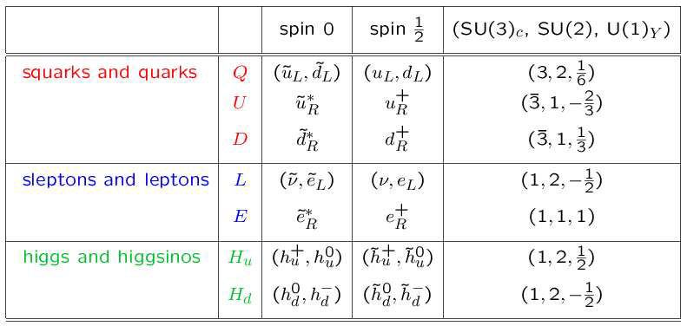
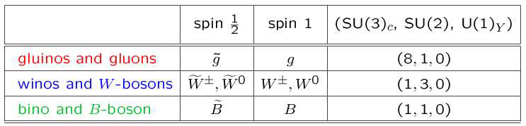
Background
Supersymmetry

Slide 12
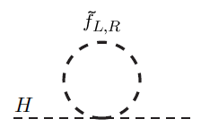
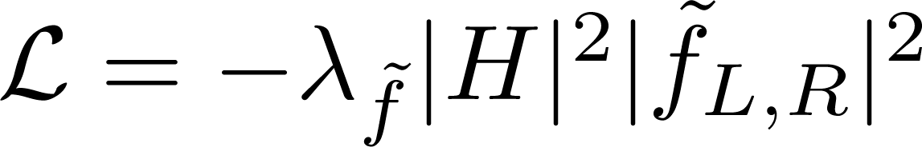
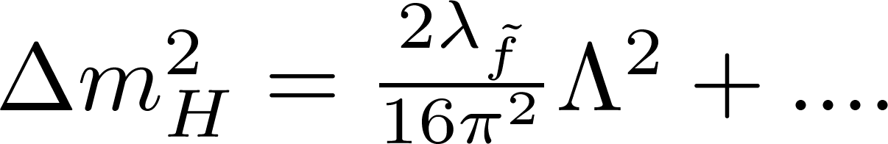
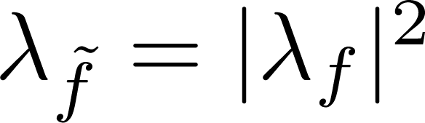
Background
Interesting Features of Supersymmetry
SUSY Solves the instability in the Higgs mass
SM contribution
SUSY contribution
+
As a consequence of supersymmetry
Quadratic divergence will cancel

Slide 13
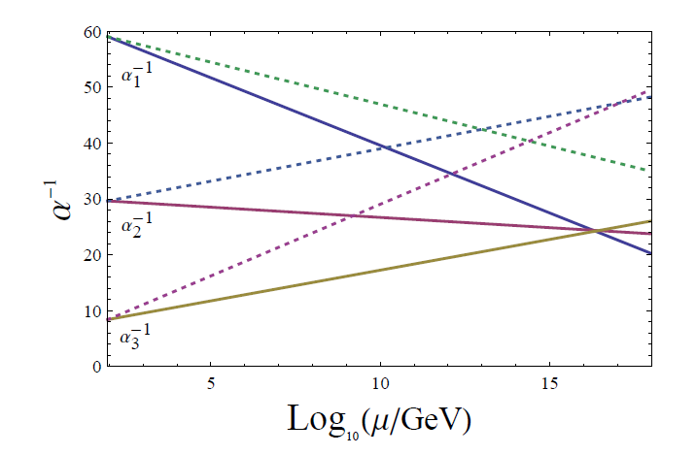
Background
Interesting Features of Supersymmetry
Gauge coupling unification
Unification of couplings at high scale
Grand Unification Theory ( GUT)
has dark matter candidate
provides a natural mechanism for EWSB
sets upper bound on the lightest Higgs mass < 130 GeV

Slide 14
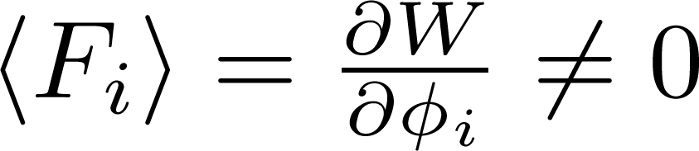
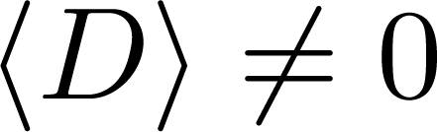
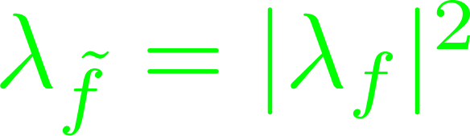
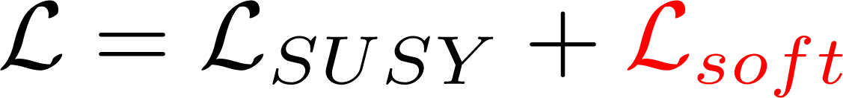
Background
Supersymmetry Breaking
Can SUSY be an exact symmetry?
For each fermionic state there is a bosonic state with the same mass
Experimentally excluded, SUSY must be broken symmetry!
Supersymmetry is spontaneously broken
OR
The relation,
, must be maintained in an broken
supersymmetric theory.

Slide 15



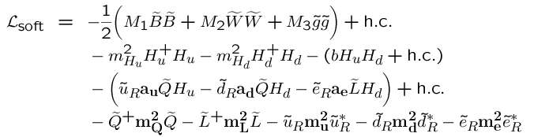
Background
Supersymmetry Breaking
Classification of Soft breaking terms
scalar mass terms:
trilinear scalar interactions:
gaugino mass terms:
bilinear terms:
soft terms in MSSM:

Slide 16

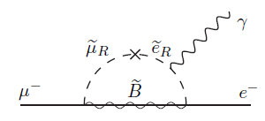
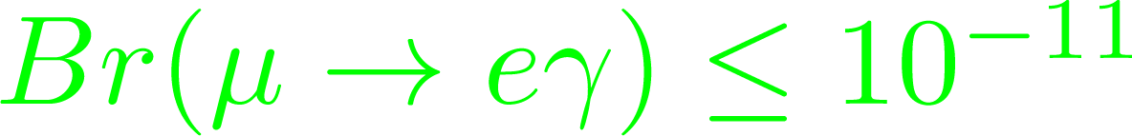
Background
Shortcomings of MSSM
Many new free parameters: about 105 free parameters
New source of flavor violation (FV)
Example: Leptonic Flavor Violation
Solution: Assume that the slepton masses are degenerate
This can be achieved by adopting GMSB
The origin of soft breaking terms
Gauge mediated supersymmetry breaking (GMSB)
Gravity mediated supersymmetry breaking

Slide 17
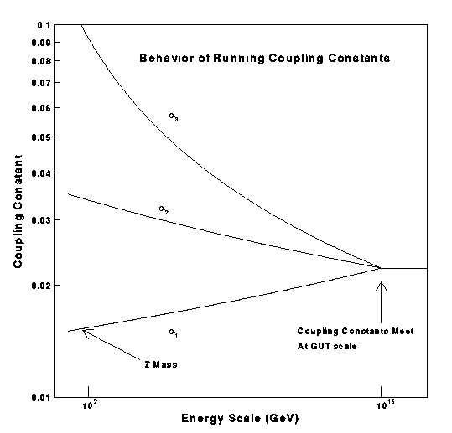
Background
Grand Unification Model (GUT)
The more symmetrical theory is, the more elegant and beautiful it is.
One simple group with one gauge coupling is more symmetrical than the SM gauge group.
In GUT, fermions are grouped in larger representations (GUT- multiplet)
GUT models contain few free parameters
MSSM
GUT

Slide 18
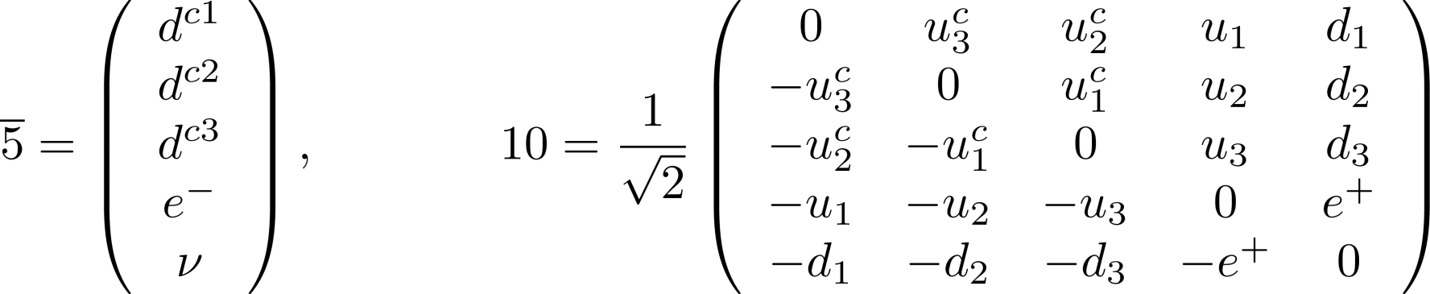


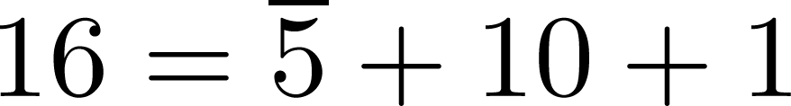
Background
Grand Unification Model
The simplest gauge group with rank 4 is SU(5) gauge group.
The 15 left-handed fermions of SM can be impeded into two large irreducible representations of SU(5).
GUT is a symmetry inside each generations of fermions, therefore it predicts relations among fermion masses
In SO(10) GUT

Slide 19
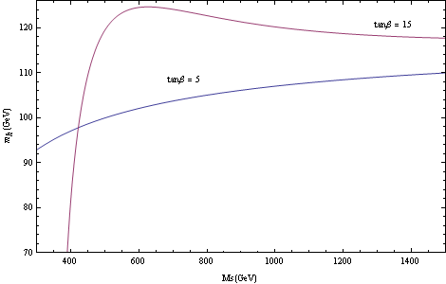
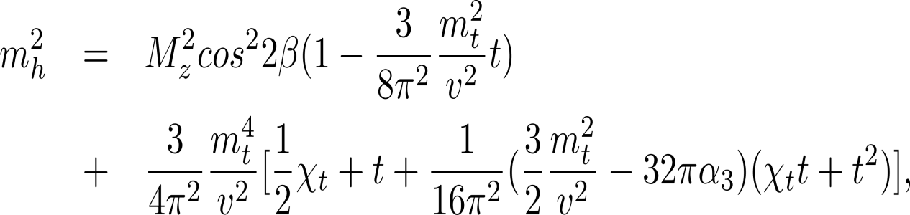
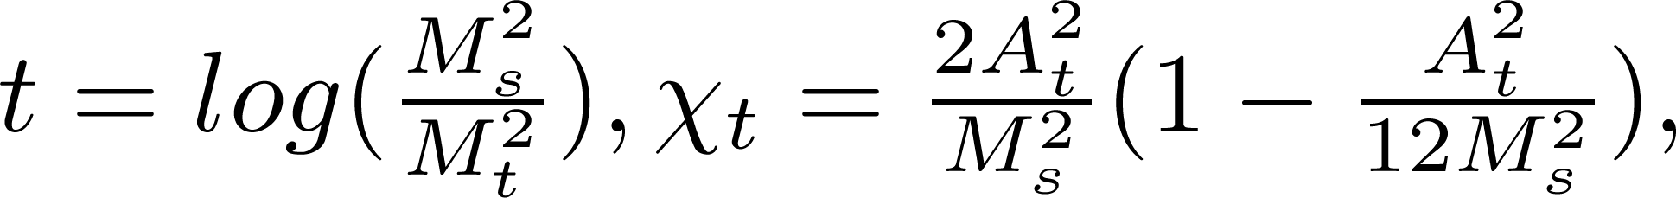
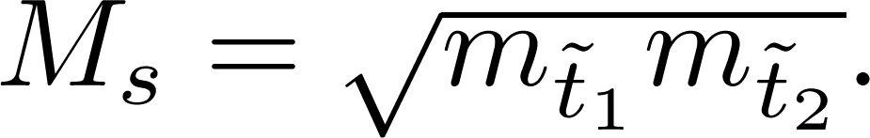
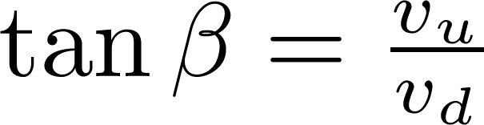
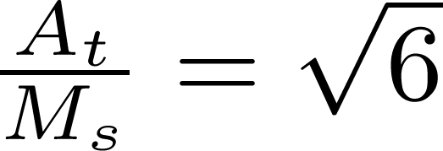

Higgs Mass Bounds in MSSM
Motivation
1-and 2- loop
Maximal Mixing Condition:

Slide 20
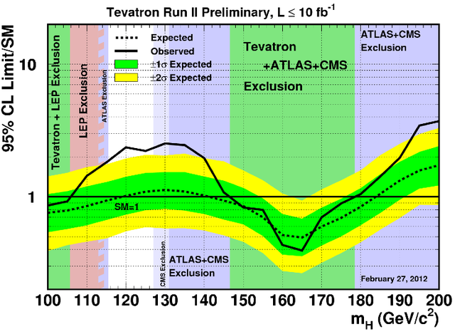
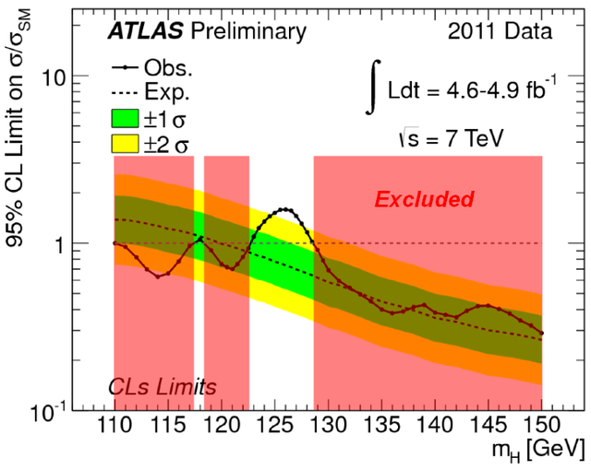
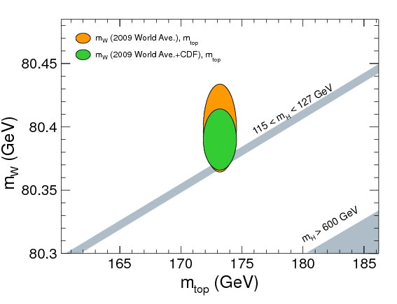
Motivation
Updated experimental results on the Higgs mass

Slide 21
Motivation
Updated experimental results on the Higgs mass
The preferred region
ATLAS and CMS. An excess of events around 124-126 GeV

Slide 22
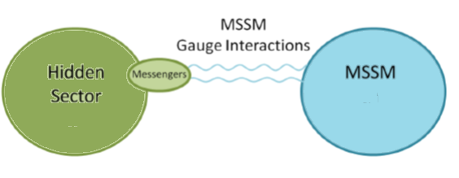

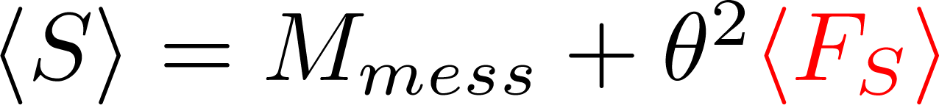
Motivation
Gauge mediated Supersymmetry breaking
Breaking supersymmetry at the renormalizable tree level interactions do not lead to acceptable spectrum .
New superfields (messengers fields)
Couple to SUSY breaking in the hidden sector
Couple indirectly to MSSM fields via gauge interactions
Have heavy masses by coupling by gauge singlet superfield

Slide 23
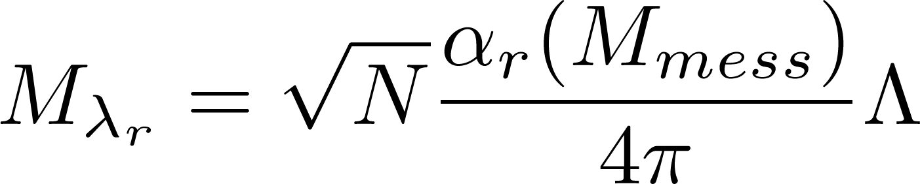
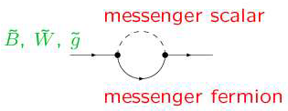
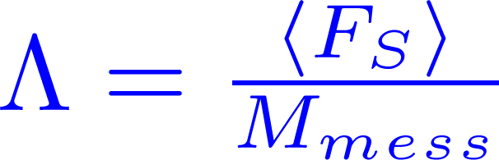
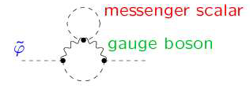
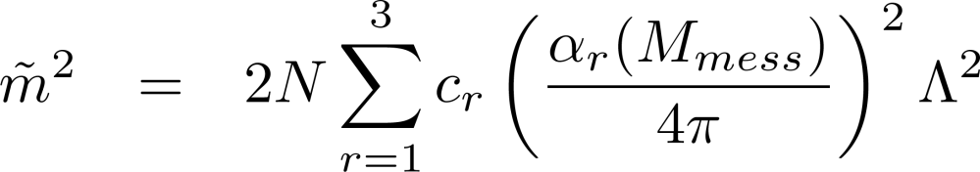

Background
Gauge mediated Supersymmetry breaking
Gaugino masses generated at one loop order
Scalar masses generated at two-loop order
Tri-linear soft terms are zero at messenger scale

Slide 24




Motivation
Features of Ordinary GMSB
Highly predictive
Flavor violation processes are naturally suppressed
Preserving gauge couplings unification
Is it possible to obtain maximal mixing ( ) in the ordinary GMSB?
No, because
Messenger- matter mixing with messenger fields belong to
can reproduce

Slide 25
Background
The Objectives
To construct GMSB model with messenger-matter mixing
that raises the lightest Higgs mass to about 125 GeV
that leads to supersymmetric particles of around sub-TeV .
The above objectives should be consistent with
flavor violation processes are suppressed in agreement with experiment .
the gravitino has a cosmological preferred sub-keV mass.

Slide 26





Higgs mass in GMSB with messenger-matter Mixing
GMSB with Messenger-Matter Mixing
Messenger fields belong to
GUT scale
Messenger scale

Slide 27






GMSB with Messenger-Matter Mixing
Messenger fields belong to
GUT scale
Messenger scale
Compare with

Slide 28




Higgs Mass bounds in the
Model
There are three parameters

Slide 29

Higgs mass in GMSB with messenger-matter Mixing
Higgs Mass bounds in the
Model

Slide 30

Higgs Mass bounds in the
Model

Slide 31





Higgs mass in GMSB with messenger-matter Mixing
Froggatt-Nielsen Mechanism
U(1) flavor symmetry is assumed.
there is a SM singlet “ flavon” field
U(1) is broken at high scale by
The hierarchy of fermion masses and mixings can be explained as a power expansion of

Slide 32






Higgs mass in GMSB with messenger-matter Mixing
Froggatt-Nielsen Mechanism
Agree with neutrino mixing angles
Agree with quark mixing angles
Additional couplings

Slide 33

Higgs mass in GMSB with messenger-matter Mixing
Flavor Violation
Mass Insertion Parameters:
The messenger-matter couplings reintroduce the flavor violation
are generated by the exotic Yukawa couplings.

Slide 34

Flavor Violation

Slide 35

Conclusion
The SM is not a complete theory, we need to go beyond the SM
Although SUSY has several advantages such solving the hierarchy problem and obtaining the unification of gauge couplings. It contains many free parameters and contains new sources of flavor violation processes.
GMSB scenario not only reduces the free parameters of MSSM from 105 to only 5 parameters but also naturally solves the SUSY flavor problem.
Introducing messenger –matter mixing in GMSB models raises the lightest Higgs mass up to 125 GeV along with sub-TeV mass of supersymmetric particles. Such a mixing would make GMSB models compatible with the recently reported hints on .
These results are consistent with the gauge and exotic Yukawa couplings being perturbative and unified at the GUT scale as well as the FCNC being suppressed in agreement with experimental bounds.

